Slide 1
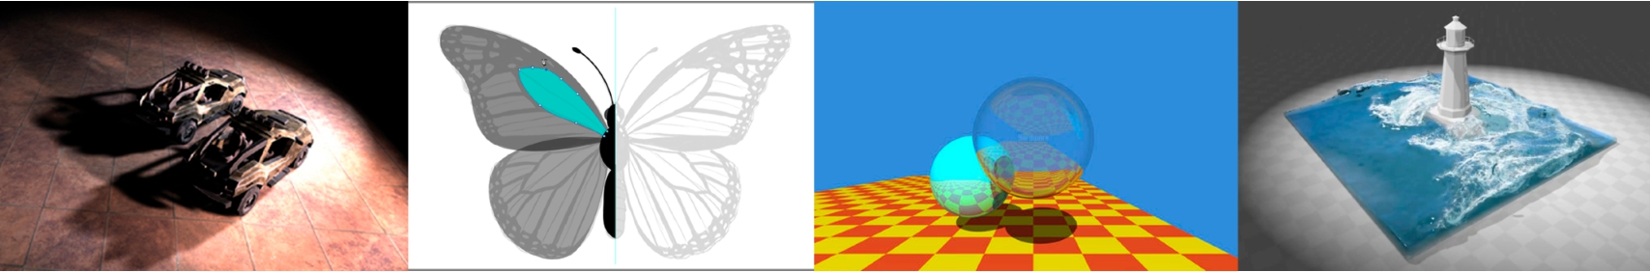
Introduction to Computer Graphics GAMES101, Lingqi Yan, UC Santa Barbara
Lecture 13:
Ray Tracing 1
(Whitted-Style Ray Tracing)
http://www.cs.ucsb.edu/~lingqi/teaching/games101.html

Slide 2
Announcements
• Homework 4 — 252 submissions so far
• Homework 1 — 80 resubmissions so far
• For universities that use this course
- Feel free to do so, and if you need scores
- On your side: give me a name (TA or professor)
On my side: give you access
You determine whether to account for resubmissions
GAMES101 2 Lingqi Yan, UC Santa Barbara

Slide 3
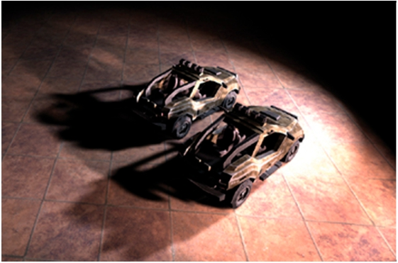
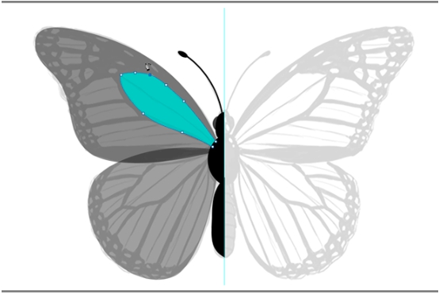
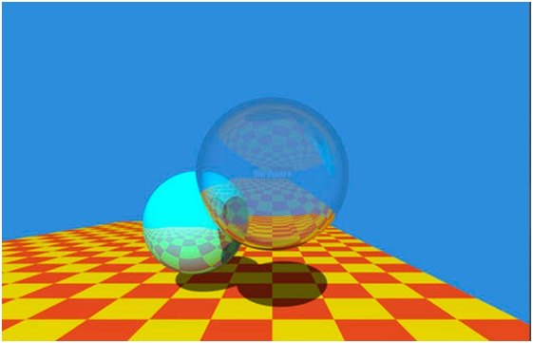
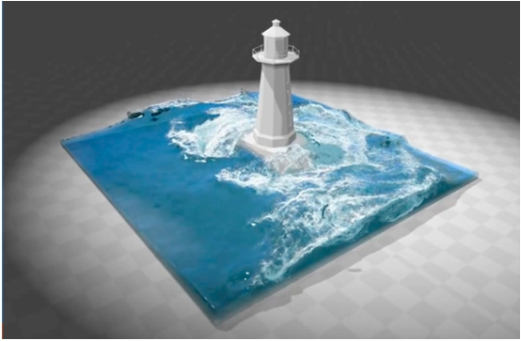
Course Roadmap
Rasterization
Ray tracing
Geometry
Animation / simulation
GAMES101 3 Lingqi Yan, UC Santa Barbara

Slide 4
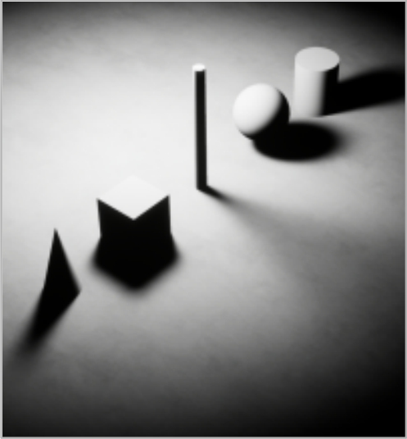
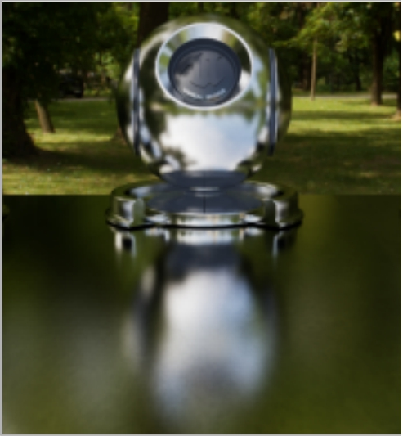
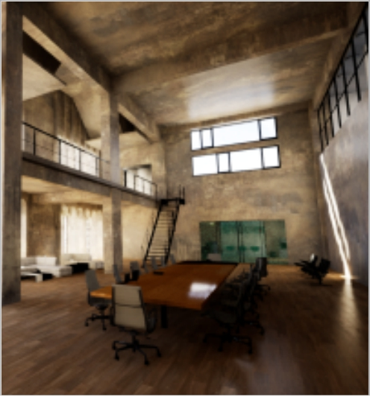
Why Ray Tracing?
• Rasterization couldn’t handle global effects well - (Soft) shadows
- And especially when the light bounces more than once
t
lar
Ambient Occlusion
Glossy reflect
Global Illumination
Indirect ilumination
GAMES101 4 Lingqi Yan, UC Santa Barbara

Slide 5
Why Ray Tracing?
• Rasterization couldn’t handle global effects well - (Soft) shadows
- And especially when the light bounces more than once
t
lar
Ambient Occlusion
Glossy reflect
Global Illumination
Indirect ilumination
GAMES101 4 Lingqi Yan, UC Santa Barbara

Slide 6
Why Ray Tracing?
• Rasterization couldn’t handle global effects well - (Soft) shadows
- And especially when the light bounces more than once
t
lar
Ambient Occlusion
Glossy reflect
Global Illumination
Indirect ilumination
GAMES101 4 Lingqi Yan, UC Santa Barbara

Slide 7
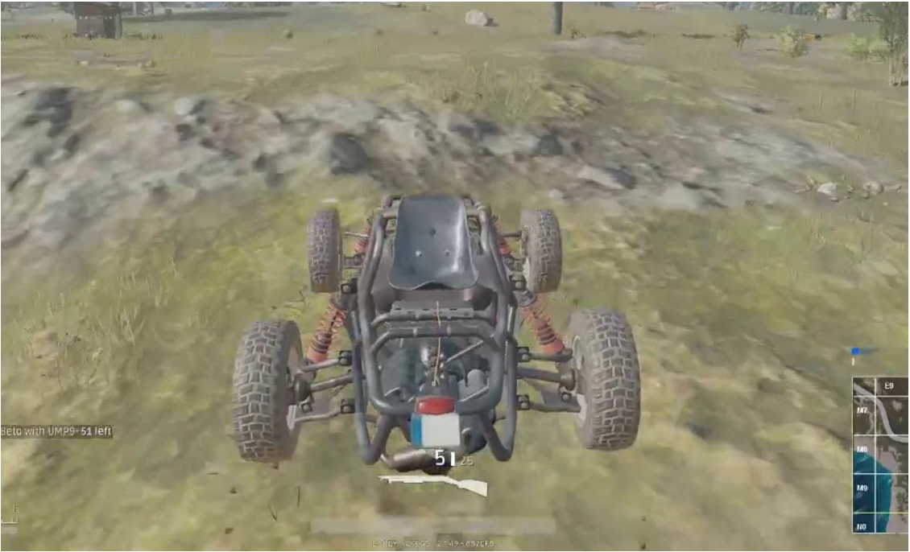
Why Ray Tracing?
• Rasterization is fast, but quality is relatively low
Buggy, from PlayerUnknown’s Battlegrounds (PC game)
GAMES101 5 Lingqi Yan, UC Santa Barbara

Slide 8
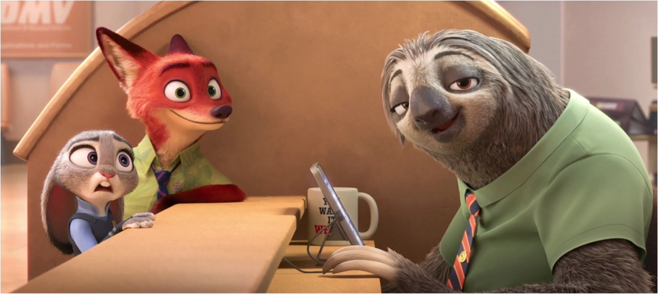
Why Ray Tracing?
• Ray tracing is accurate, but is very slow - Rasterization: real-time, ray tracing: offline
- ~10K CPU core hours to render one frame in production
Zootopia, Disney Animation
GAMES101 6 Lingqi Yan, UC Santa Barbara

Slide 9
Basic Ray-Tracing Algorithm

Slide 10
Light Rays
Three ideas about light rays
1. Light travels in straight lines (though this is wrong)
2. Light rays do not “collide” with each other if they cross
(though this is still wrong)
3. Light rays travel from the light sources to the eye (but
the physics is invariant under path reversal - reciprocity).
“And if you gaze long into an abyss, the abyss also gazes into you.” — Friedrich Wilhelm Nietzsche (translated)
GAMES101 8 Lingqi Yan, UC Santa Barbara

Slide 11
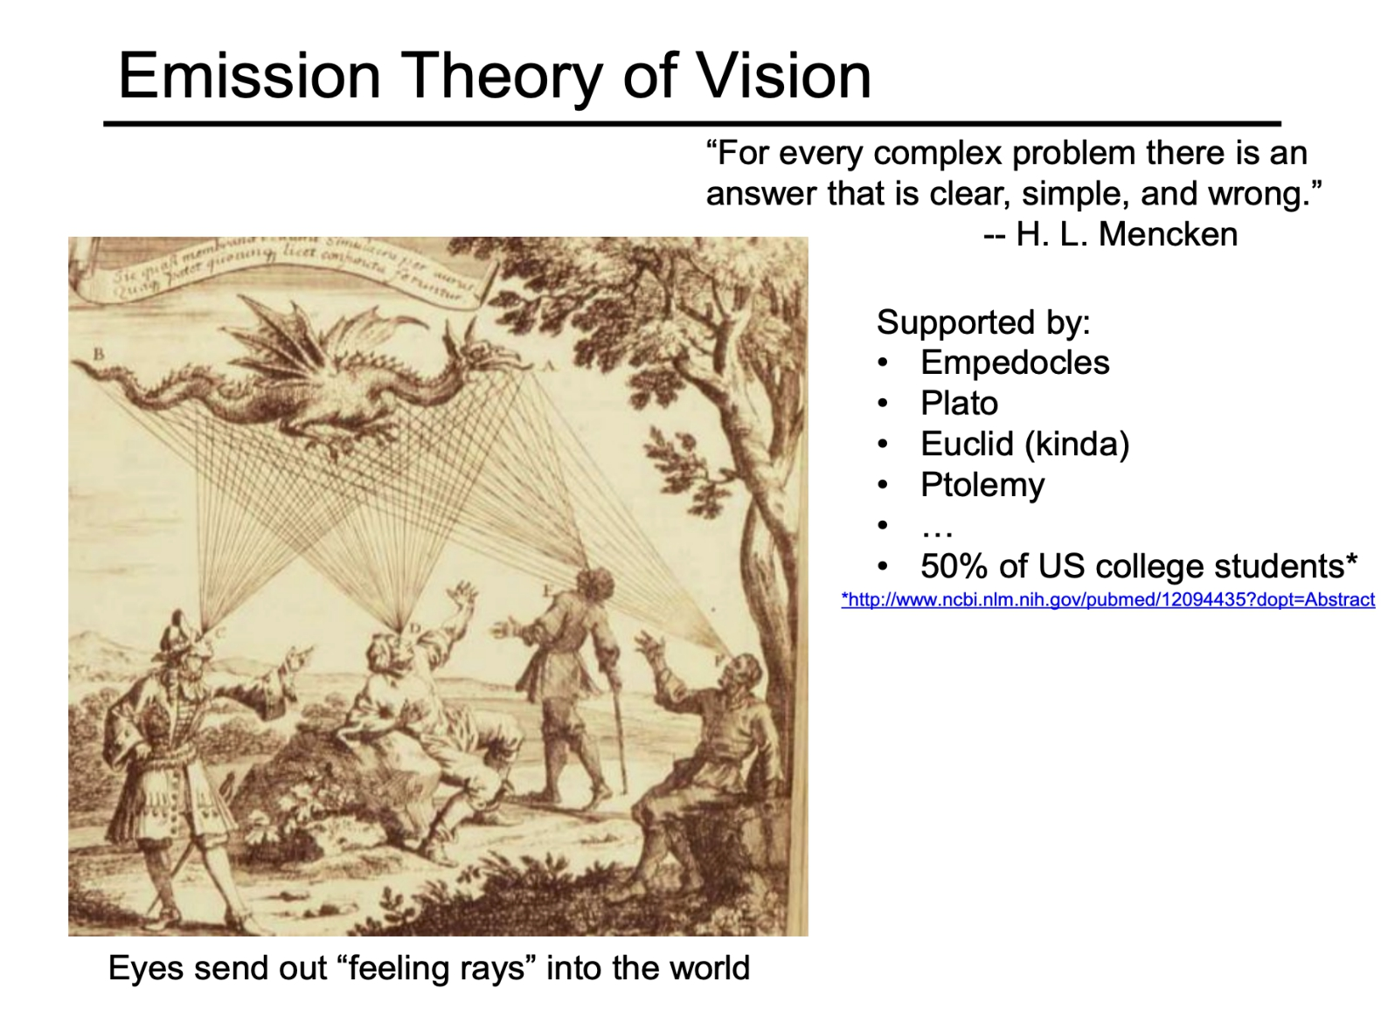
Slide courtesy of Prof. Alexei Efros, UC Berkeley

Slide 12
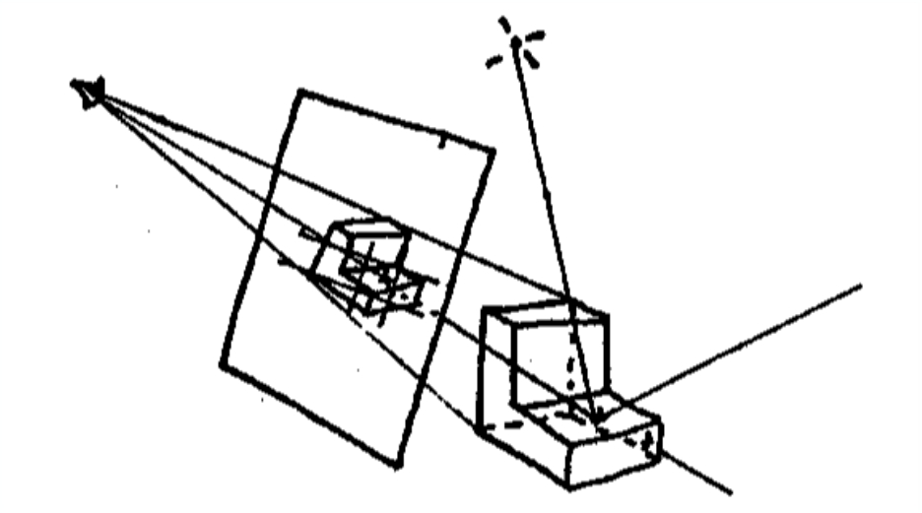
Ray Casting
Appel 1968 - Ray casting
1. Generate an image by casting one ray per pixel
2. Check for shadows by sending a ray to the light
GAMES101 10 Lingqi Yan, UC Santa Barbara

Slide 13
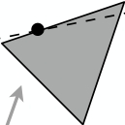
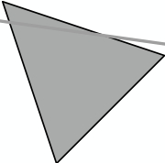

Ray Casting - Generating Eye Rays
Pinhole Camera Model
eye ray
(starts at eye and goes
through pixel)
closest scene intersection point
note: more intersection points
eye point
image plane
(or the near plane
in perspective projection)
light source
GAMES101 11 Lingqi Yan, UC Santa Barbara

Slide 14
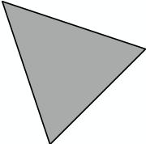
Ray Casting - Shading Pixels (Local Only)
Pinhole Camera Model
eye ray
(starts at eye and goes
through pixel)
eye point
image plane
perform shading calculation
here to compute color of pixel
(e.g. Blinn Phong model)
light source
GAMES101 12 Lingqi Yan, UC Santa Barbara

Slide 15
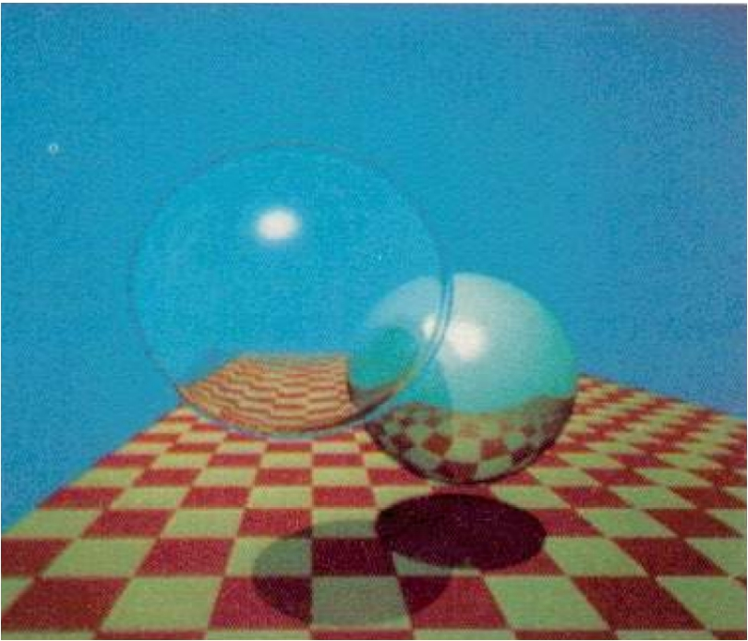
Recursive (Whitted-Style) Ray Tracing
“An improved Illumination model for shaded display” T. Whitted, CACM 1980
Time:
• VAX 11/780 (1979) 74m
• PC (2006) 6s
• GPU (2012) 1/30s
Spheres and Checkerboard, T. Whitted, 1979
GAMES101 13 Lingqi Yan, UC Santa Barbara

Slide 16


Recursive Ray Tracing
eye point
image plane
light source
GAMES101 14 Lingqi Yan, UC Santa Barbara

Slide 17
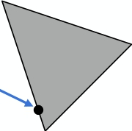
Recursive Ray Tracing
Reflected ray
(specular reflection)
eye point
image plane
light source
GAMES101 15 Lingqi Yan, UC Santa Barbara

Slide 18
Recursive Ray Tracing
Refracted rays
(specular transmission)
eye point
image plane
light source
GAMES101 16 Lingqi Yan, UC Santa Barbara

Slide 19
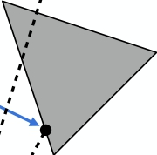
Recursive Ray Tracing
eye point
image plane
light source
Shadow rays
GAMES101 17 Lingqi Yan, UC Santa Barbara

Slide 20
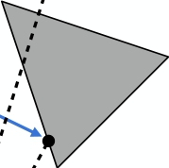
Recursive Ray Tracing
secondary rays
primary ray
eye point
image plane shadow rays
light source
GAMES101 18 Lingqi Yan, UC Santa Barbara

Slide 21

Recursive Ray Tracing
GAMES101 19 Lingqi Yan, UC Santa Barbara

Slide 22
Ray-Surface Intersection

Slide 23




Ray Equation
Ray is defined by its origin and a direction vector Example:
Ray equation:
0  t < 1
point along ray “time” origin (normalized) direction
GAMES101 21 Lingqi Yan, UC Santa Barbara

Slide 24


Ray Intersection With Sphere
Ray:
r(t) = o + t d, 0  t < 1
0
(
phere:z
p
(
0
c)2
R
et and solve for
What is an intersection?( R2 = 00
The intersection p must satisfy both
ray equation and sphere equation·
p : (p atc2)2+ btR·+2N=c =0 0, where
(
(
(p
o + t d
0
0
0
R2 = 00
c)2
Solve for intersection:
(o + t d c)(2 Rc2) =· d0
c = (o c) · (o c)
at2 + bt + c = 0, where
GAMES101 22
4ac
att2 + btt + c =00, wherehere
t t here
2(
2(
( Lingqi Yan, UC Santa Barbara
R2
b ± pb2
2( · d

Slide 25


Ray Intersection With Sphere
(( c)2 R2 = 00
( 0
olve for intersection:
(
: (
(o + t d
c)2 R2 = 0
t t 0 re
t t 0 re
at2 + bt + c = 0, where
0
0
c
a = 2(2(d · d
b = 2((( o c) · od
c = (o c) · (
pb2
2
t = 2
2a
2a
GAMES101
t
t
t
t
0 re
0 re
2
2
p
p 22 4ac
Lingqi Yan, UC Santa Barbara
2 4ac
c)
4ac
4ac
R22
2
2(
2(
(
(
b ± p
23

Slide 26
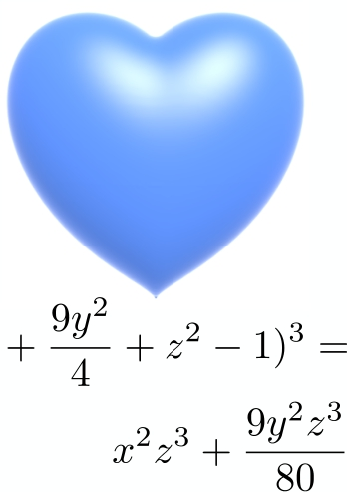
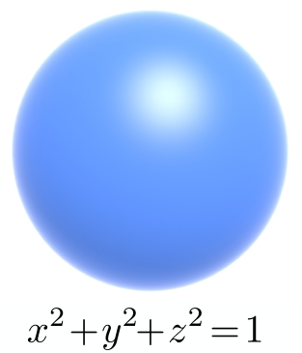
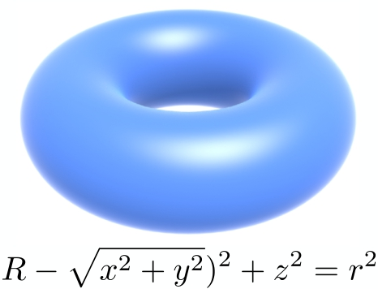
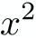
Ray Intersection With Implicit Surface
Ray: r(t) = o + t d, 0  t < 1
0
p) = 0
General implicit surface: p : f ( = 0
z 0
Substituteet ray equation:and solve forf (o + t d) = 0
d) = 0
Solve for real,( positive roots 0
·
· N
(
GAMES101 24 Lingqi Yan, UC Santa Barbara

Slide 27
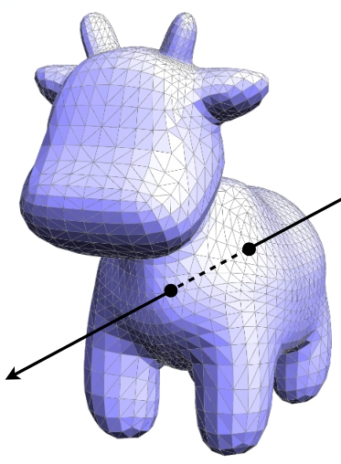
Ray Intersection With Triangle Mesh
Why?
• Rendering: visibility, shadows,
lighting …
• Geometry: inside/outside test
How to compute?
Let’s break this down:
• Simple idea: just intersect ray with each triangle
• Simple, but slow (acceleration?)
• Note: can have 0, 1 intersections
(ignoring multiple intersections)
GAMES101 25 Lingqi Yan, UC Santa Barbara

Slide 28


Ray Intersection With Triangle
Triangle is in a plane
• Ray-plane intersection
• Test if hit point is inside
triangle
Many ways to optimize…
GAMES101 26 Lingqi Yan, UC Santa Barbara

Slide 29
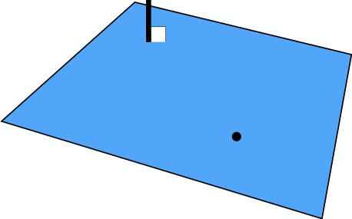
Plane Equation
Plane is defined by normal vector and a point on plane
xample:
( p
= + t
Plane Equation x(if p satisfiesy it,zthen p is on the plane):
= , 0  t <(1 0
p : (p p et x y andz solve0
x
all points on plane
GAMES101
z
one pointet
on plane
0
normal vector
(
27
p
(
and solve for(p
et t and
p0) · N = (o +
Lingqi Yan, UC Santa Barbara
d
d · N
0 o N t = p0

Slide 30


Ray Intersection With Plane
Ray equation:
r(t) = o + t d, 0  t < 1
( 0
Plane equation: = t < 1
r(tz)p=: o(p+0t dp,0)0·  t <0 1 p0) · Net= 0 zand solve0 for
+ czSolve+ d =for0 intersection( et and 0solve forx y z
et and· solve( for 0
t
p p0 · N(
·
p0 (p
o) · N Check:· N
r(t) = o + t d, 0  t < 1
d · N
p : (p p0) · N = 0
GAMES101 ax + by + cz + d = 0 28 Lingqi Yan, UC Santa Barbara

Slide 31
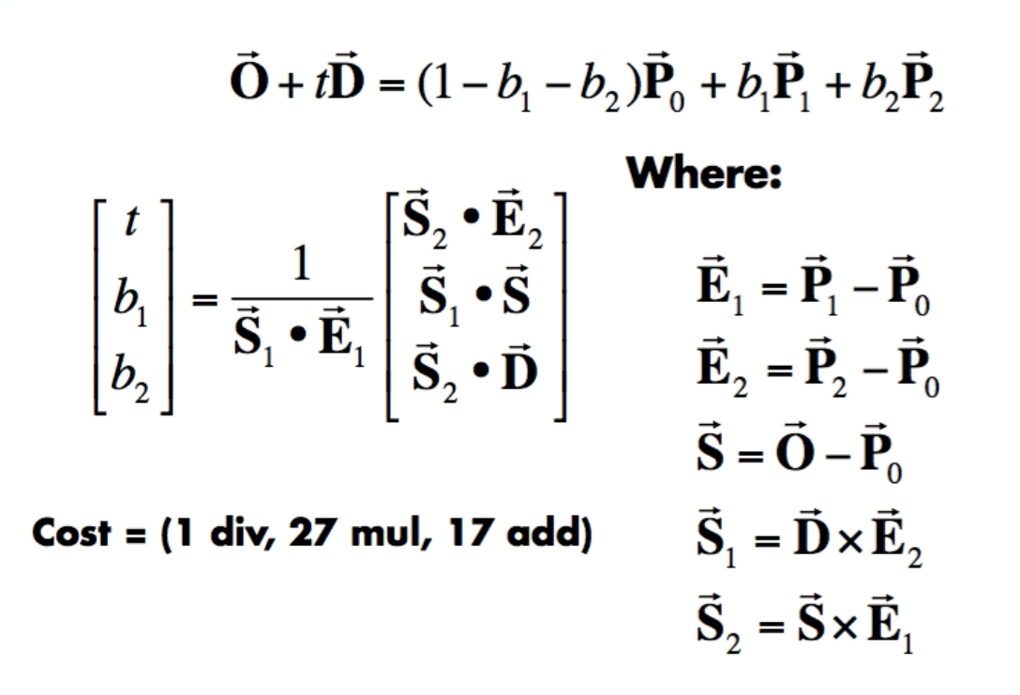
Möller Trumbore Algorithm
A faster approach, giving barycentric coordinate directly Derivation in the discussion section!
Recall: How to determine if the “intersection” is inside the triangle?
Hint:
(1-b1-b2), b1, b2 are barycentric coordinates!
GAMES101 29 Lingqi Yan, UC Santa Barbara

Slide 32
Accelerating Ray-Surface
Intersection

Slide 33
Ray Tracing – Performance Challenges
Simple ray-scene intersection
• Exhaustively test ray-intersection with every triangle
• Find the closest hit (i.e. minimum t)
Problem:
• Naive algorithm = #pixels ⨉ # traingles (⨉ #bounces)
• Very slow!
For generality, we use the term objects instead of triangles later (but doesn’t necessarily mean entire objects)
GAMES101 31 Lingqi Yan, UC Santa Barbara

Slide 34
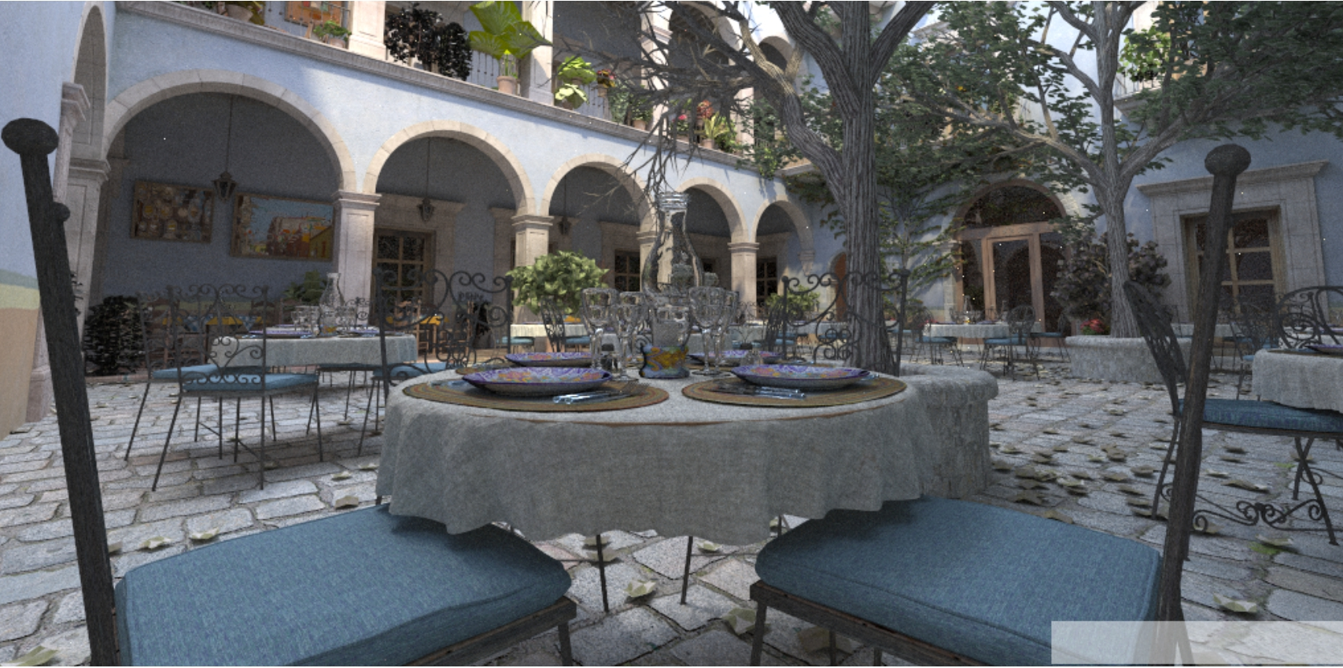
Ray Tracing – Performance Challenges
Jun Yan, Tracy Renderer
San Miguel Scene, 10.7M triangles

Slide 35
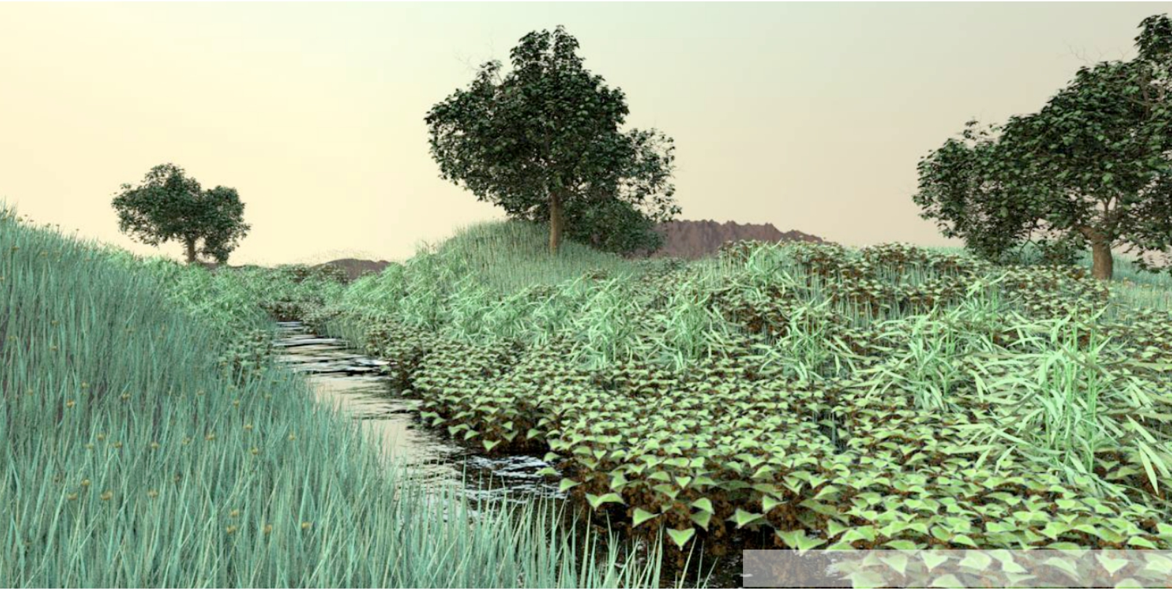
Ray Tracing – Performance Challenges
Deussen et al; Pharr & Humphreys, PBRT
Plant Ecosystem, 20M triangles

Slide 36
Bounding Volumes

Slide 37



Bounding Volumes
Quick way to avoid intersections: bound complex object with a simple volume
• Object is fully contained in the volume
• If it doesn’t hit the volume, it doesn’t hit the object
• So test BVol first, then test object if it hits
GAMES101 35 Lingqi Yan, UC Santa Barbara

Slide 38
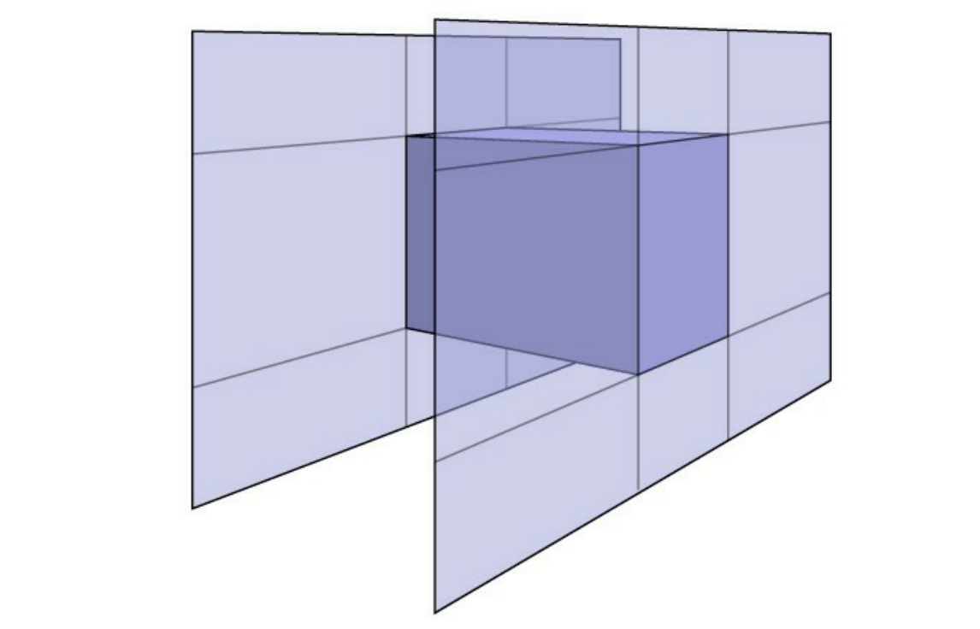
Ray-Intersection With Box
Understanding: box is the intersection of 3 pairs of slabs
Specifically:
We often use an Axis-Aligned Bounding Box (AABB)
(轴对⻬包围盒)
i.e. any side of the BB is along either x, y, or z axis
GAMES101 36 Lingqi Yan, UC Santa Barbara

Slide 39
Ray Intersection with Axis-Aligned Box
2D example; 3D is the same! Compute intersections with slabs and take intersection of tmin/tmax intervals
tmax x0
y0
y1
x1
y0
y1
tmaxx0
x1
y0
y1
tmax
tmin tmin
d o, d
o o, d o, d
x1 y tmin x y1
x0 x1 Note: tmin < 0 x 0 x 1 x 0 y
Intersections with x planes Intersections with y planes Final intersection result
How do we know when the ray intersects the box?
GAMES101 37 Lingqi Yan, UC Santa Barbara

Slide 40
Ray Intersection with Axis-Aligned Box
• Recall: a box (3D) = three pairs of infinitely large slabs
• Key ideas
- The ray enters the box only when it enters all pairs of slabs - The ray exits the box as long as it exits any pair of slabs
• For each pair, calculate the tmin and tmax (negative is fine)
• For the 3D box, tenter = max{tmin}, texit = min{tmax}
• If tenter < texit, we know the ray stays a while in the box
(so they must intersect!) (not done yet, see the next slide)
GAMES101 38 Lingqi Yan, UC Santa Barbara

Slide 41
Ray Intersection with Axis-Aligned Box
• However, ray is not a line
- Should check whether t is negative for physical correctness!
• What if texit < 0?
- The box is “behind” the ray — no intersection!
• What if texit >= 0 and tenter < 0?
- The ray’s origin is inside the box — have intersection!
• In summary, ray and AABB intersect iff - tenter < texit && texit >= 0
GAMES101 39 Lingqi Yan, UC Santa Barbara

Slide 42

Why Axis-Aligned?
(
o) · N
t = (p0
General
p0
d
subtractions, 6 multiplies, 1 division
=
0
=)
(
 t <
t = p0x
and solve for
dx
0
Slabs perpendicular to x-axis
(
y
d · N
p
Nz
et
ox
p
) · N d · N
1 subtraction, 1 division
GAMES101 40 Lingqi Yan, UC Santa Barbara

Slide 43
Thank you!
(And thank Prof. Ravi Ramamoorthi and Prof. Ren Ng for many of the slides!)

